Slide 1
Implementing Disability Access in Health Care

Slide 2
Sutter Health
Large non-profit health system throughout Northern California
Large and small hospitals
Clinics
Physician networks
Program of All-Inclusive Care for the Elderly and Care at Home
Advanced Illness Management program
Sutter Health support and learn from the more than 3 million people in their care—nearly 1 percent of the U.S. population

Slide 3
Program Structure
System Level Positions:
Disability Access Officer brought on in 2007 to design the program
Accessibility Architect
ADA Equipment Officer
Information Services Online Services Team
Each patient care entity
Designated an ADA Coordinator
28 Coordinators are now in place

Slide 4
Sutter Resources for our Affiliates
Sutter Program Resources
Template Policies
Training Modules
Expertise
Site Survey to Identify Physical Barriers
Help with Identifying Accessible Equipment
Local Entity ADA Coordinator

Slide 5
Elements of a Successful Program

Slide 6
Depict People with Disabilities for Care Professionals

Slide 7
Disability Facts
The most frequently reported disabilities were in mobility and cognition and higher prevalence among older age groups but 93-95% of people with disabilities are not wheelchair users
At least 1 in 5 persons is reported to have a disability
Disability-specific disparities in health care access were common, particularly among young (18–44) and middle-aged (45–64) adults [Reported by the CDC]

Slide 8
Care Disparities
Living with a disability presents barriers to accessing health care and navigating the health care system (World Health Organization, 2016)
People with disabilities were more than twice as likely to not receive medical care because of cost in 2009 (CDC, 2010b)
People with disabilities are significantly less likely to receive preventive care (Krahn et al., 2015)

Slide 9
Use the Experts!
Due to barriers, individuals with disabilities are less likely to get routine preventative medical care than people without disabilities. Accessibility is not only required, it is important medically so that minor problems can be detected and treated before turning into major and possibly life-threatening problems.
--U.S. Department of Justice & U.S. Department
of Health and Human Services

Slide 10
Help Care Providers Understand Culturally Competent Care
Cultural competence is the ability to provide effective care to cultural groups
This ability rests on
Attitudes
Skills
Policies
Practices

Slide 11
Train about Attitudinal Barriers
Stereotyping
Assuming poor quality of life or
Persons with disabilities are unhealthy
Stigma, prejudice, and discrimination
Beliefs that a person with a disability cannot care for themselves
Disability is a personal tragedy
Cannot make decisions, or
Participate in society

Slide 12
Train about Attitudinal Barriers
The views and beliefs care providers can get in the way of care
Use positive, independent pictures of people with disabilities
Must work toward the same clinical outcomes
E.g. providers must not examine a patient in a wheelchair because of difficulty in transferring a patient to the examination equipment
Unless examination does not rely on position of the patient to achieve the outcome—for example blood draw

Slide 13
ADA Program Components
ADA Responsibilities
Develop Policies that Guide Staff on Providing Accessible Care
Assure Process for Accommodating Patients
Maintain Accessible Facilities & Features
Install Accessible Medical Equipment

Slide 14
ADA Program Components
ADA Responsibilities
Effective Complaint Process
Problem-solving of Patient Issues
Remove Barriers in Exiting Facilities
Build Compliant Facilities

Slide 15
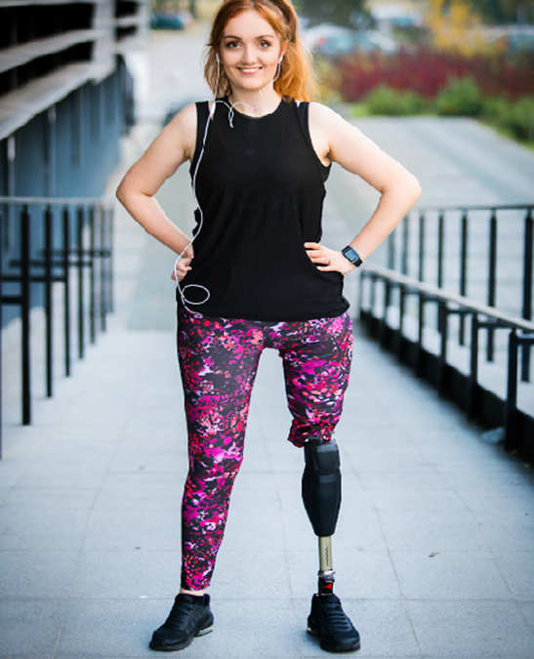
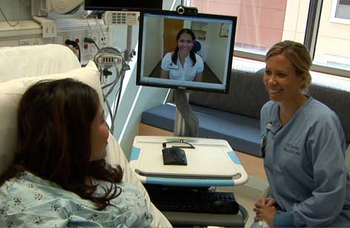
The law requires us to provide the same care to our patients
Our policies guide us on how to do this

Slide 16
Policies Must Incorporate Practices & Procedures for Accessible Care Practices
Responsibility For Accessible Facilities and Services
Communication Assistance
Mobilizing Lifting and Transferring: Inpatient/Outpatient Services
Accessible Inpatient/Outpatient Medical Facilities and Equipment
Weight Measurement
Service Animals
Guidance for Maintaining an Accessible Environment
Medical Imaging And Diagnostic/Therapeutic Procedures
Adaptations in Mammography

Slide 17
Specific Policy Elements

Slide 18
Effective Communication Policy
Communication assistance is necessary through auxiliary aids & services or other accommodations
Health Care Providers
People with Disabilities
Deaf
Hard-of-hearing
Blind or visually impaired
Cognitive disability
Speech disability

Slide 19
Effective Communication Policy
Communication policy may be needed for:
Difficulty understanding spoken or written language
Difficulty producing speech or verbal or written language
Difficulty hearing (hard of hearing or D/deaf)
Difficulty with vision or blindness affecting written communication

Slide 20
Effective Communication Policy
Communication must be effective for the person considering the complexity of the communication
Consult about what will be most effective for the person and the situation
Communication accommodation must be available at the time needed

Slide 21
Effective Communication Policy
Include practical considerations and contact information
Policy guidance on how to engage vendors or contacts for all auxiliary aids and services necessary to assure participation
Spell out how to evaluate simple vs. complex communication

Slide 22
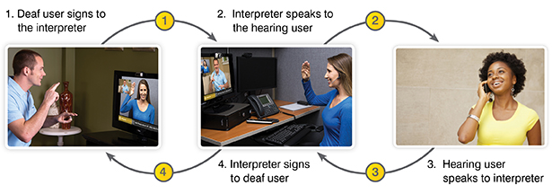
Effective Communication Policy
The auxiliary aid or service must be designed for the type of communication involved
Telephone: relay service or speech to speech
In person: video remote interpreting or onsite interpreting

Slide 23
Effective Communication Policy
Effective communication with family/companions is particularly critical in health care settings for several reasons:
Legally authorized to make health care decisions
May need to help with information or instructions
May be next of kin or health care surrogate with whom medical staff need to communicate
Designated by the patient to communicate with medical staff about the patient's symptoms, needs, condition, or medical history

Slide 24
Effective Communication Policy
Types of Auxiliary Aides & Services that Provide Effective Communication
Qualified readers, taped texts, audio recordings
Braille materials and displays
Screen reader software
Magnification software
Large print materials
Accessible electronic and information technology
Real-time computer-aided transcription services
Other effective methods of making visually delivered materials available to individuals who are blind or have low vision

Slide 25
Effective Communication Policy
Tools that can be made readily available in a clinic if a patient has communication limitations:
Alphabet or picture board
White board or other way for patient to draw or write
Pock talker
Pictograms

Slide 26
Service Animals Policy
Key elements:
How to determine whether an animal is a service animal
Understand the appropriate questions that can be asked
Know that there is no need for jacket or marking
Current regulations specify service animals are dogs or, in some cases, miniature horses

Slide 27
Service Animals Policy
Know when a service animal can be asked to leave
Must always allow person to return to get care
Lay out the decision-maker and considerations when there are decisions to be made
For example: Conflicts with immuno-compromised conditions or other care issues

Slide 28
Maintaining an Accessible Environment Policy
Create a procedure and designate staff responsible for periodic review and maintenance of spaces so they are free of movable, “low hanging fruit,” and other non-construction barriers
Policy should include specific requirements for how the entity will maintain the site free of barriers
Procedure: ­specific process and the staff designated to maintain the spaces so movable and non-construction elements are not barriers to access for persons with disabilities

Slide 29
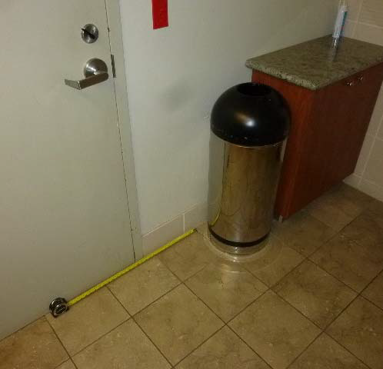
Maintaining an Accessible Environment Policy
Movable barriers that obstruct required clearances:
Trash cans and carts
Linen hampers
Clinical & procedural carts
Hallway stored items such as IT equipment
Chairs and end tables
EVS cleaning equipment & supplies
Landscape maintenance and tools
Bicycle parking
Group gatherings

Slide 30
Policies that Adapt Care Procedures
Patients with disabilities will require adaptation to receive the same care – which includes:
Weight Measurement
Inpatient & Outpatient Mobilizing Lifting and Transferring
Mammography Adaptations
Medical Imaging and Diagnostic/Therapeutic Procedures

Slide 31
Policies that Adapt Care Procedures
Persons with disabilities may have functional limitations that require adaptations to the imaging procedures or other accommodations for a successful image
Examples can include, but are not limited to:
Inability or limited ability to walk, balance, or stand | Difficulty lifting arms or reaching
Spasticity or tremors | Fatigue or chronic pain
Kyphotic, atypical, slumped posture or a protruding abdomen | Lack of sensation/coordination
Lack of flexibility | Limb abnormalities

Slide 32
Accessible Equipment & Spaces
Provide accessible space in patient rooms, examination/treatment/procedure rooms, an accessible route to services, restrooms, etc.
Defines accessible medical equipment and ancillary equipment needed for examination/treatment/procedure rooms & spaces
Maintain equipment necessary to accommodate patients with disabilities – including visual notification devices, assistive listening devices, telephones with amplified headsets, TTY, etc.

Slide 33
Install & Use Accessible Medical Equipment

Slide 34
Accessible Medical Equipment
DOJ expects that equipment will be used to make examinations, procedures, and treatment accessible
Federal standards are in development & Sutter participated in the development
There is no mandated scoping criteria so evaluate what makes sense for each practice
Minimum of 1 accessible piece of equipment for each practice/office/clinic
More if large practice or several physicians who do not share office space

Slide 35
Accessible Medical Equipment
Your system will need to examine your model of care, size and figure out what works in your system/facilities
Sutter used knowledge of disability access plus healthcare practices to create its own standards to fulfill the needs of our patients
Sutter is tracking the process and bringing in the requirements into our sourcing process to assure our use of the most accessible equipment
Sutter standards must be used in all new and existing spaces

Slide 36
Accessible Medical Equipment
Equipment Capturing Weight
Beds
Lift Equipment
Exam Tables & Procedure Chairs
Medical Imaging & Mammography Equipment

Slide 37
Problem-Solving for Patient/Family/Companion Issues
Designate & train staff who can assist in problem-solving patient issues
Best Practice: Need to have knowledge of disability and how people with disabilities navigate and live in the world
This differs from a clinical understanding of diagnoses

Slide 38
Accommodation
Accommodations are assistance or alterations made to equipment, procedures, or systems that enable a person with a disability to participate in care, get on and position selves for care, communicate effectively and participate in care to the maximum extent possible
An accommodation may be a modification to an existing environment or process to increase the participation by an person with a disability --CDC

Slide 39
Determine Needs for Accommodations
Consult the patient about what will work
Ask function-based questions—rather than diagnostic information
Do you need a disability-related accommodation or assistance?

Slide 40
Complaint Process
Nearly all healthcare entities have a complaint process
Make sure the complaint process is available in alternative formats and communicates that assistance and/or accommodations are available where needed
Train those who respond to complaints on disability access issues and the importance of talking with the person with a disability to assure understanding of the issues

Slide 41
Remove Barriers in Existing Facilities
Building codes provide accessibility to buildings but are triggered only when you remodel or construct new facilities
Architects may not understand this obligation unless you hire someone with specific training or focus on disability access
It is a common belief that having the plans approved by the building official assures full accessibility

Slide 42
Physical Accessibility: Beyond the Survey
Barrier removal should prioritize the biggest barriers prohibiting people with disabilities from navigating your space and benefiting from all programs and services
An effective method is to have a survey done by a knowledgeable access expert who includes this information in the survey data
Another method could be to use an advisory group of persons with disabilities using your service to weigh in on the issues

Slide 43
Physical Accessibility
Accessibility
Remove barriers & bring existing buildings into compliance over time
Affirmative action required to make spaces accessible & provide accessible care
Building Code
Need to follow most recent building code when you build or alter facilities
No affirmative obligation—triggered when you alter or construct facilities
Key is to provide accessible care even if you need to use other methods, i.e. moving the location, directional signage
The only focus is to follow the code when you engage in construction

Slide 44
Additional Disability Access Principles

Slide 45
Discrimination
A failure to take steps necessary to ensure that no individual with a disability is excluded, denied services, segregated or otherwise treated differently
It is essential that a person with a disability receives medical services equal to those received by a person without a disability
If you provide a service, benefit, education, etc. everyone should have access to it

Slide 46
Basic Principle to Underlie All Activities
If you provide
It, you must provide it for all
Goods, services, facilities, privileges, advantages, or accommodations

Slide 47
Eligibility Criteria Must be Relevant & Neutral
The criteria used for the eligibility for a service must be relevant to the service offered
May not discriminate due to disability
Examples:
Requirement that you must be able to transfer yourself for entry into a psychiatric facility
Require a drivers license for loaning equipment

Slide 48
Legitimate Safety Requirements Necessary for Safe Operation Allowed When Based on Actual Risks
All safety requirements must be based on actual risks—not stereotypes or assumptions
Service animal with health conditions may be barred but must be based on situation

Slide 49
No Surcharge for Access!
Clear policy guidance for staff
Often comes up on alternate format requests or ASL interpreter costs
Especially where the involvement is for a deaf family member and not the patient

Slide 50
Modify Policies and Procedures if Required to Provide Access
May need to modify policies and procedures to permit the use of power-driven mobility devices by individuals with mobility disabilities or miniature ponies
Modify scheduling practices to include a procedure that allows for getting accommodation needs for patients
Address care practices that must be modified such as capturing weight

Slide 51
Remove Barriers That Are Readily Achievable
Where barriers are not removed through a construction fix, use other methods!
Directional signage to the accessible facilities
Relocating activities to accessible locations

Slide 52
Methods for Providing Program Access
Acquisition of equipment
Reassignment of services to accessible sites
Staff assistance
Alteration of existing facilities and construction of new facilities
Other methods that result in making its services, programs, or activities readily accessible to and usable by individuals with disabilities
Example: Where doors are not easily managed by persons may use automatic door openers to accommodate
Building code experts will say: “This isn’t required by code!”

Slide 53
DOJ Requires Web Accessibility
The obligation to make websites accessible exists right now
The current regulations do not spell out how to make websites accessible
The best practices for website and application accessibility is found in Web Content Accessibility Guidelines, an international collaboration by experts in digital accessibility

Slide 54
Everyone Brings Expertise to the Table
Stress to care providers--you know more about healthcare and your responsibilities
The patient is an expert at her/ his capabilities and types of accommodation(s) needed
Understanding the patient’s expertise will assure an effective care partnership

Slide 55
Training Relevant to Roles
Training that is relevant to the specific roles in health care
For example
Safety officers and plant operations are very involved in the physical environment in care centers
Train on how to assist in maintaining the physical space free of movable barriers
Specialized training for staff where job requires specific in-depth training

Slide 56
Carol Bradley
Disability Access /504 Officer
Sutter Health Office of the General Counsel
2200 River Plaza Drive
Sacramento , California 95833
(916) 286-8419
bradlec1@sutterhealth.org

